Slide 1



TAMIL POLITICAL TEXT EMOTION RECOGNITION
HARISH .M & JYOTHSNA .V
BY GROUP 3

Slide 2


PROBLEM STATEMENT
Tamil, being a low-resource language, presents unique challenges such as linguistic nuances, dialectical variations, and a scarcity of annotated data.
Existing emotion recognition models are largely trained on English and other widely spoken languages, with limited support for Tamil.
PROPOSED SOLUTION
Develop an Emotion Identification model capable of classifying emotions into one of seven distinct categories, by utilizing appropriate NLP tools to process Tamil texts, extract meaningful insights, and accurately determine sentiment.

Slide 3

DATASET ANALYSIS
DATASET
OVERVIEW
The dataset consists a training set with 4,352 samples and a testing set with 544 samples, with uneven class distribution. (that may result in less accurate classification.)
CATEGORY
TYPES
🔴 Negative – Criticism or Disapproval.
✅ Positive – Approval or Agreement.
🔍Substantiated – Well-supported claims 💬 Opinionated – Strong personal views.
😏 Sarcastic – Irony or Mockery.
⚖ Neutral – Unbiased or Factual.
❓ None of the above

Slide 4
PROJECT PROGRESS
1. We plan to further analyze the dataset, apply BERT/Multilingual BERT (MBERT) embeddings, and compare machine learning models like Random Forest, XGBoost, and SVM to evaluate their effectiveness.
2. While challenges such as language complexity, class imbalance, and sarcasm detection remain, we look forward to understanding the potential of advanced NLP models for sentiment analysis in Tamil.

Slide 5
PROJECT TIMELINE
Phase | Weeks | Key Tasks
Literature Review | Weeks 1-2 | Research & finalize methodology, consult with mentors.
Dataset overview, Feature Extraction and Analysis | Weeks 3-4 | Clean dataset, generate TF-IDF or BERT embeddings, or fuse embeddings.
Model Training & Fine-Tuning | Weeks 5 -15 | Train models, fine-tune and optimize hyperparameters, experiment with alternatives.
Experimental Insights Reporting | Week 15 - 20 | Generate and analyze metrics, create visualizations, document findings.

Slide 6
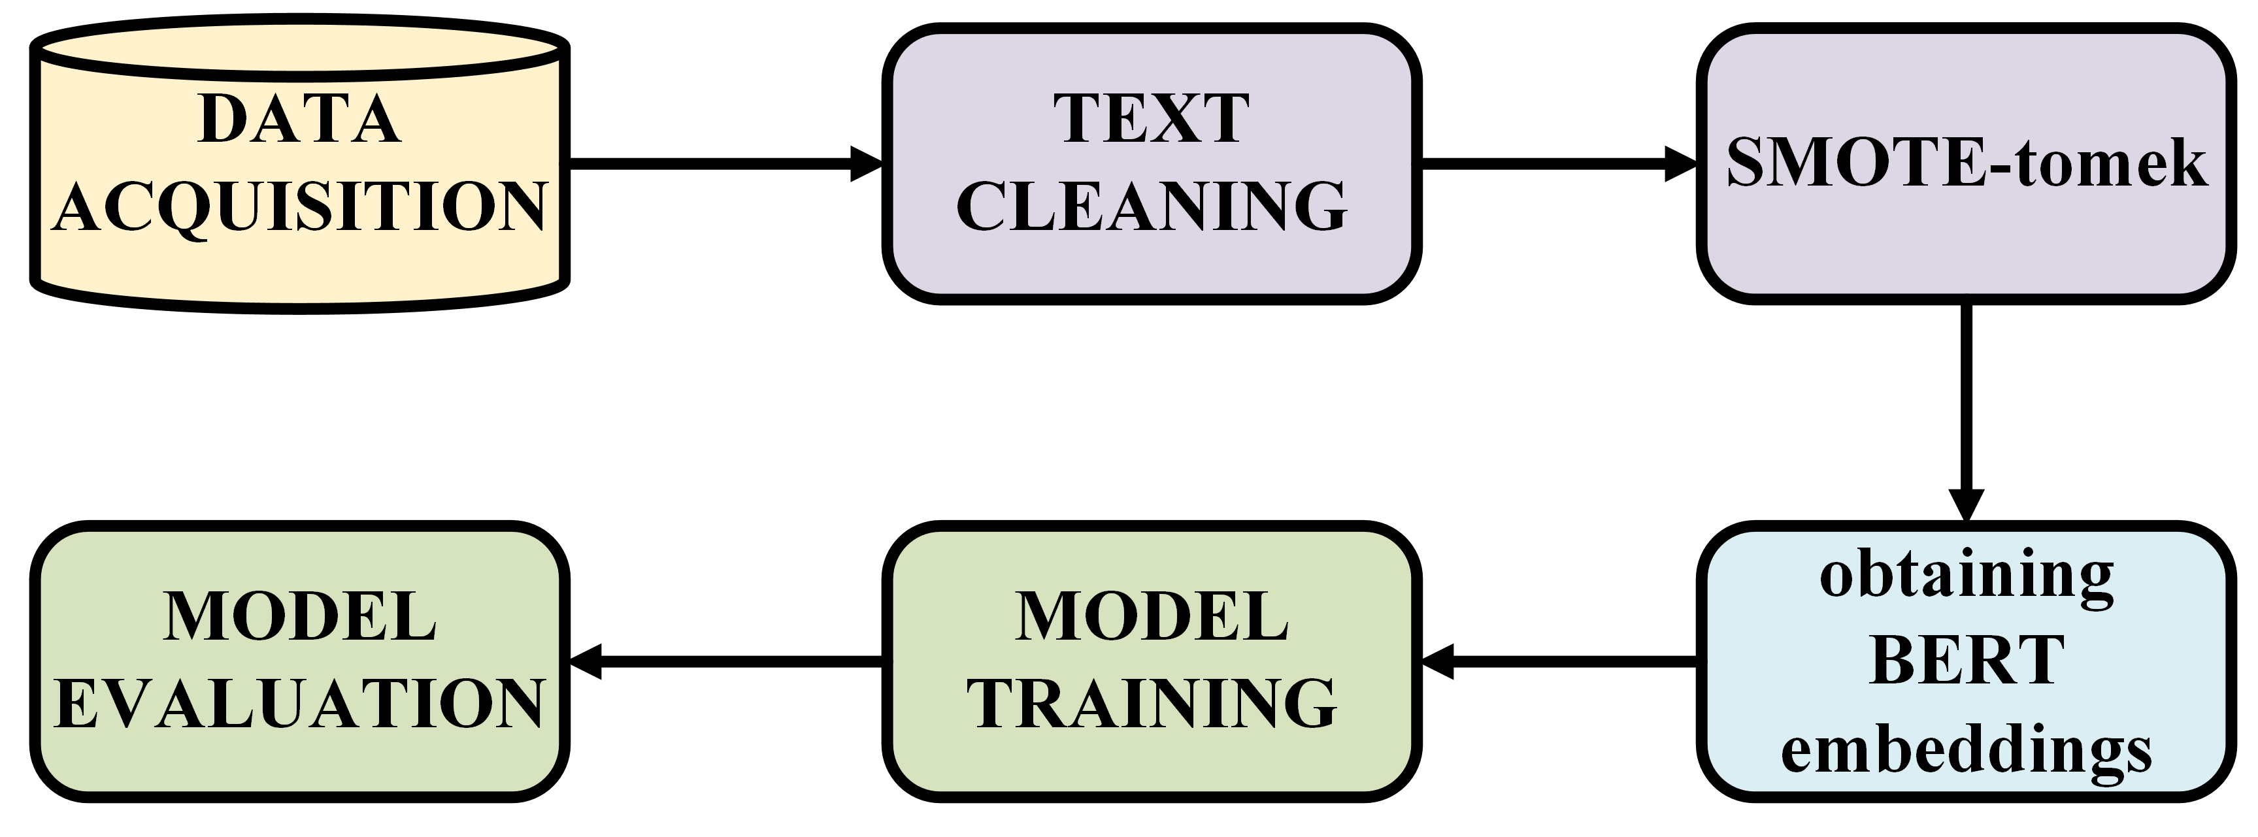
METHODOLOGY FLOWCHART

Slide 7
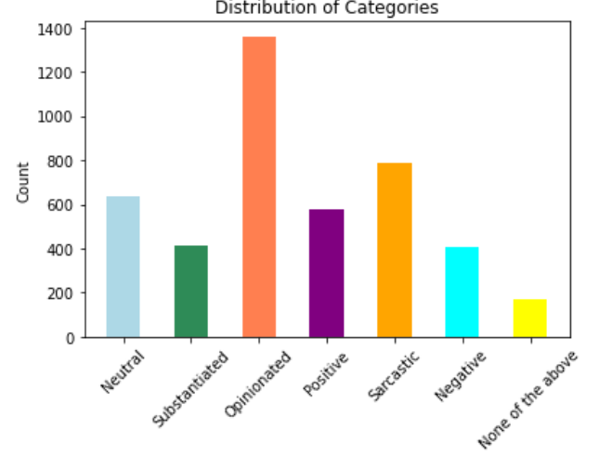
Handling Class Imbalance
Challenge: Imbalanced data leads to biased predictions.
Issues:
Overrepresented classes dominate.
Underrepresented classes might get low recall.
Model learns biased decision boundaries.
Solution (SMOTE-Tomek):
SMOTE generates synthetic samples for minority classes.
Tomek Links removes borderline samples to refine boundaries.
Outcome: Balanced data improves classifier performance, reduces bias, and enhances generalization across emotions.

Slide 8

BERT- Bidirectional Encoder Representations from Transformers
BERT (Bidirectional Encoder Representations from Transformers) is a machine learning model developed by Google for natural language processing (NLP) tasks.
It uses a transformer-based architecture to understand the context of words in a sentence by analysing them bidirectionally (both left and right).
BERT is pre-trained on large text corpora and can be fine-tuned for specific tasks like sentiment analysis, question answering, and text classification. Its bidirectional nature allows it to capture more nuanced language meanings compared to traditional models.

Slide 9
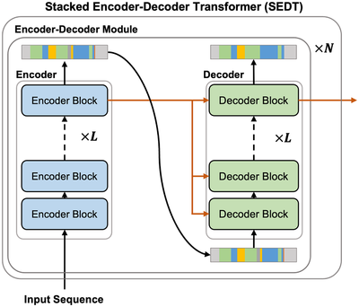
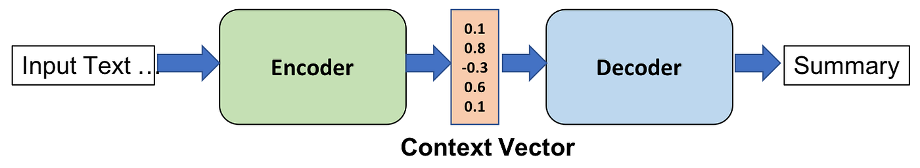
Why BERT?
Fig. A transformer model used for translation tasks
Transformer Encoder Layers: Uses self-attention and feedforward layers to process input bidirectionally, allowing the model to capture context from both past and future words.
In BERT, self-attention allows the model to weigh the importance of different words in a sentence to understand context, while feedforward layers process the attention-weighted representations to generate higher-level features

Slide 10
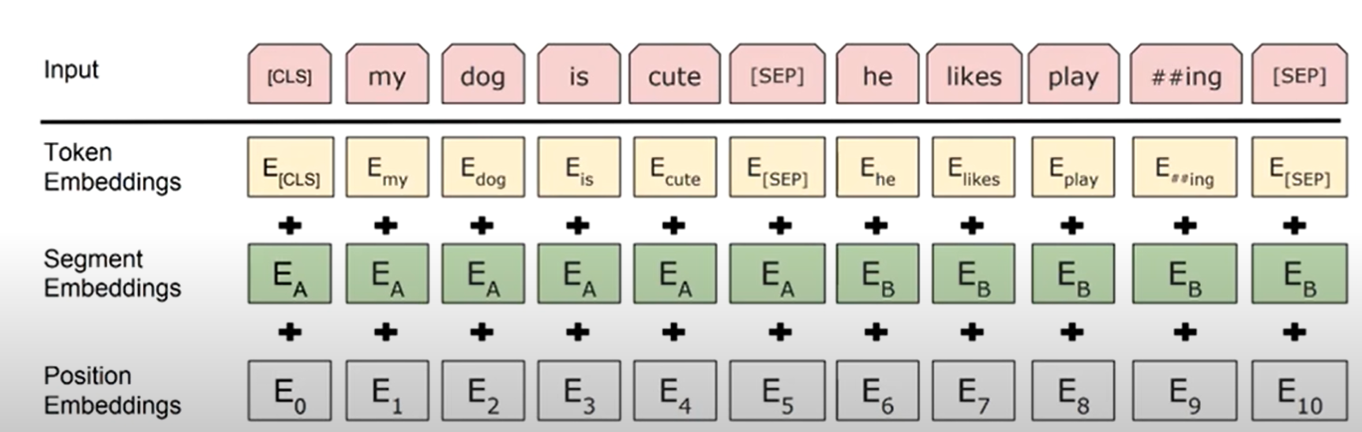

BERT Embeddings
Input Representation: Combines token embeddings, positional encodings, and segment embeddings:

Slide 11
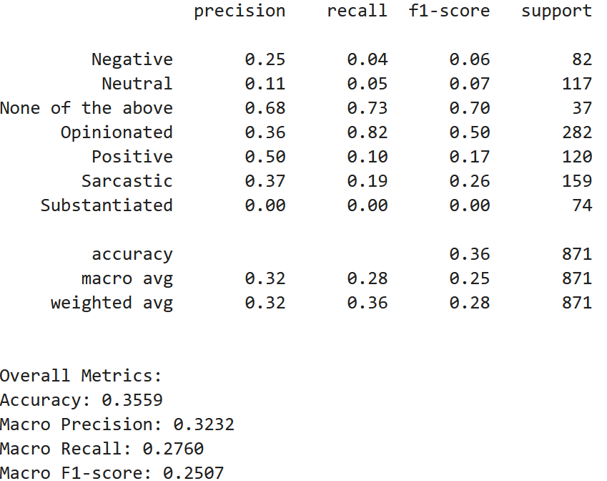
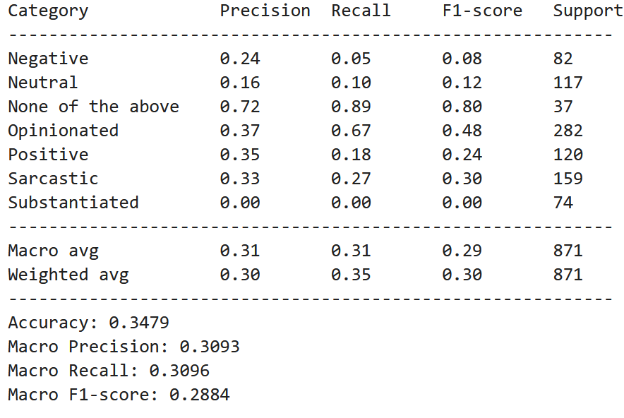
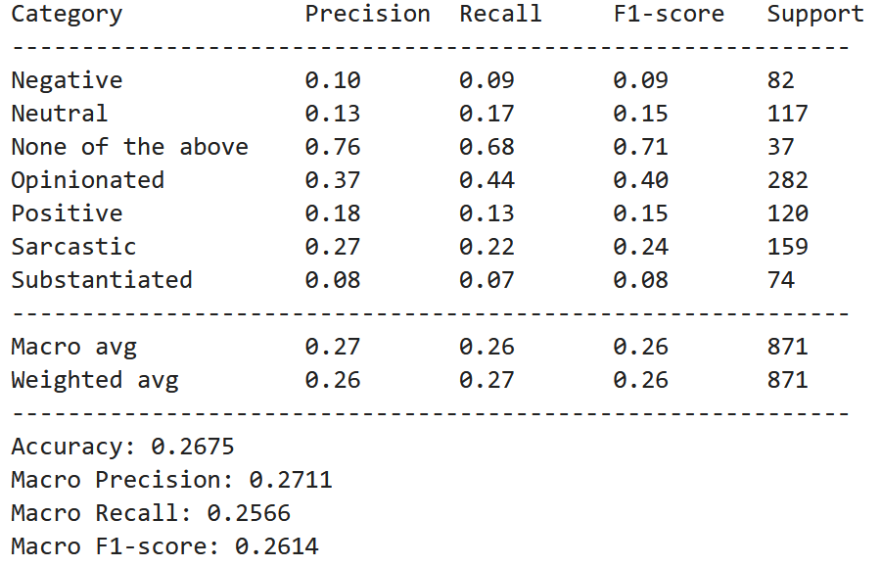

PHASE 1: Experimental Results & Undersatnding
XGBoost Classifier Performance Metrics
Random Forest Classifier Performance Metrics
SVM Classifier Performance Metrics
The sentiment analysis performed on the dataset, after translation to English, resulted in very low accuracy and F1-score, indicating that the chosen approach is ineffective.
Therefore, as part of our second approach, we will utilize m-BERT directly on the Tamil dataset to improve performance.

Slide 12
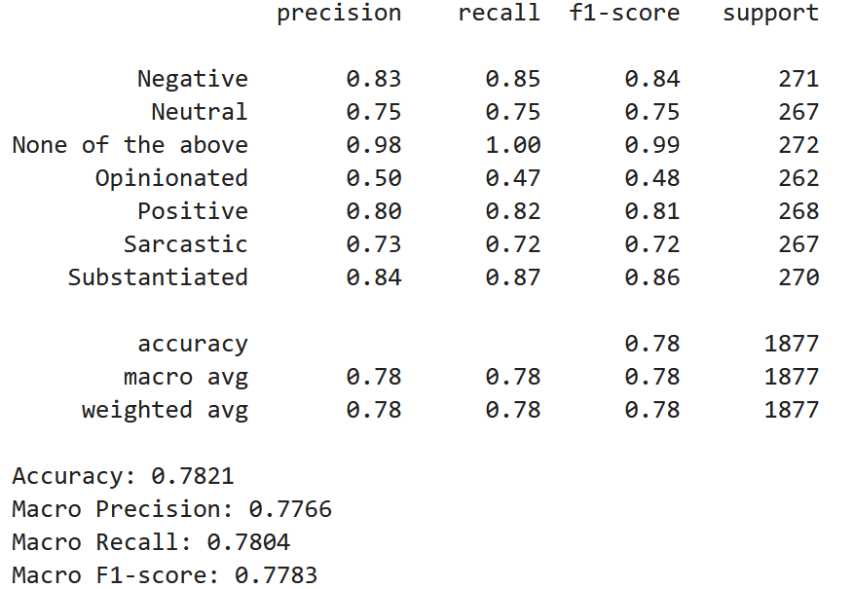
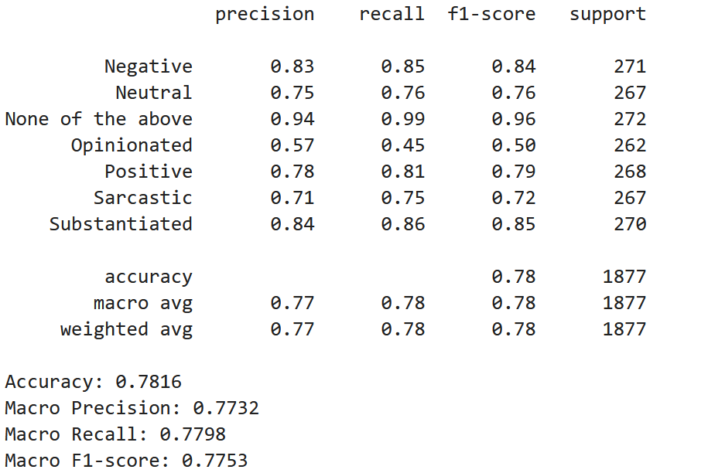
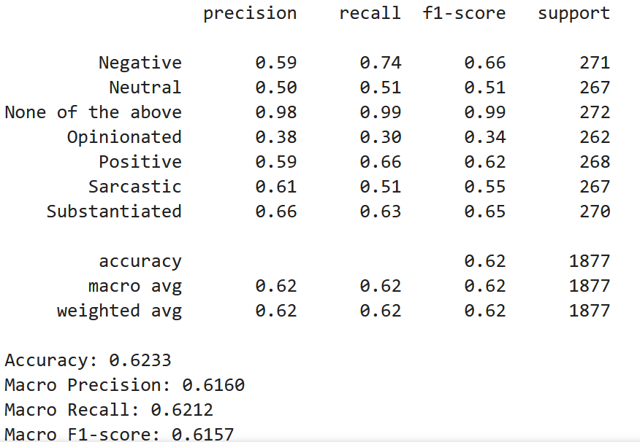
PHASE 2: Experimental Results & Undersatnding
XGBoost Classifier Performance Metrics
Random Forest Classifier Performance Metrics
SVM Classifier Performance Metrics
After applying an 80-20 train-test split on the training data, the classifiers achieved the above accuracy.
However, when evaluated on the testing data, the model performed poorly, indicating overfitting.

Slide 13
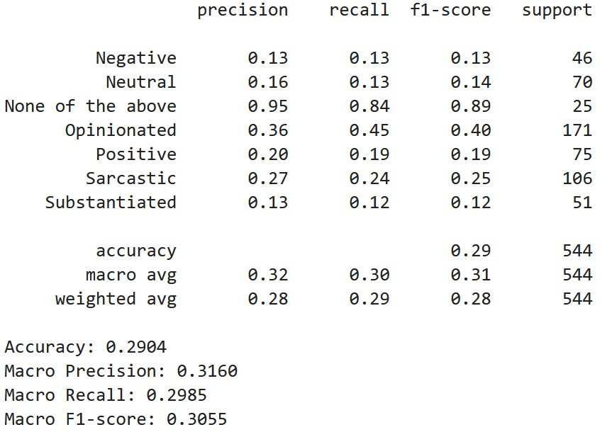
FUTURE STEPS
Challenge: Overfitting leads to poor generalization.
Issues:
• Model performs well on training data but poorly on unseen data. • Fails to generalize patterns, leading to inaccurate predictions on unseen data.
Solution:
• Lasso Regression (L1 Regularization) reduces model complexity by shrinking less important coefficients to zero. • Ridge Regression (L2 Regularization) penalizes large coefficients to prevent overfitting. • Logistic Regression with regularization helps control overfitting in classification tasks.
XG-Boost when evaluated with Separate Training data and testing datasets for Tamil language dataset

Slide 14
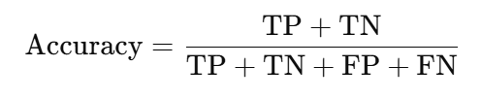



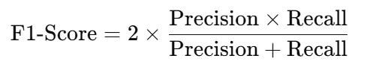
EVALUATION METRICS
1
2
ACCURACY
PRECISION
The proportion of correctly classified instances out of the total instances. It works well for balanced datasets but may be misleading for imbalanced ones.
Measures how many of the predicted positive instances are actually positive. It is crucial when false positives need to be minimized.
3
4
RECALL
F1 SCORE
Measures how many actual positive instances were correctly predicted. It is important when missing positive cases is costly.
The harmonic mean of precision and recall, balancing both metrics. It is useful for imbalanced datasets where accuracy is not reliable.

Slide 15
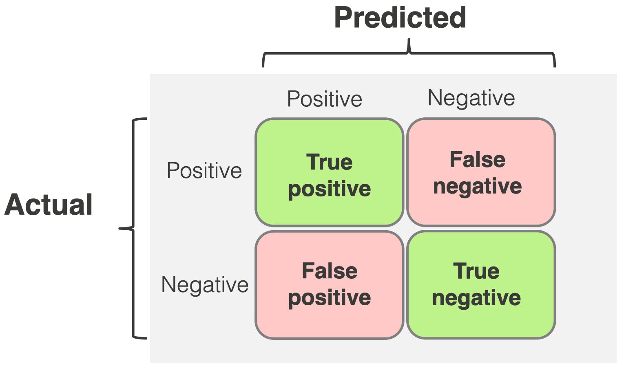
EVALUATION METRICS

Slide 16

CHALLENGES FACED
🔹 Language Complexity – Tamil’s agglutinative nature and rich morphology make sentiment analysis challenging, requiring advanced linguistic handling. 🔹 Sarcasm & Context – Sarcasm, irony, and implicit sentiment in political discourse are difficult to detect without deep contextual understanding. 🔹 Class Imbalance – Uneven distribution of sentiment classes skews model predictions, requiring techniques like oversampling or balanced loss functions. 🔹 Translation Errors – Tamil-to-English translation may introduce semantic shifts, affecting the accuracy of sentiment classification. 🔹 Computational Cost – BERT-based models demand significant processing power, necessitating optimization strategies like quantization or distillation.

Slide 17
THANK YOU
BY GROUP 3

